Slide 1

Welcome to LSS (and the Law Center)!
Fall 2026
Professor Truskett

Slide 2
LSS – Active Learning Together
The practice of law is active and collaborative.
Learn by doing - Good lawyering skills, especially writing, can only be improved by practice.
Team-based. You will be assigned into “law firms.” You are all equity partners.
Feedback-focused (receiving and giving).

Slide 3
TODAY’S AGENDA
MEET EACH OTHER
REVIEW COURSE SYLLABUS AND SCHEDULE
LEARNING HOW TO READ [THE LAW]
CH. 3 BECOMING A LEGAL WRITER EXERCISES

Slide 4
About Me - Professionally
2008 UHLC Law Center Graduate
Professors Bush, Ragazzo, and Moll were my professors
Executive Editor of the Houston Journal of International Law
Law Practice
14 years as a corporate energy attorney at Hunton Andrews Kurth LLP
Practice areas were mergers & acquisitions and commercial contracts
Partner and head of the firm’s Oil and Gas Practice Group
Teaching
Professional Writing Strategies at Law Center
8th Grade Social Studies at Schindewolf Intermediate School in the Klein ISD

Slide 5
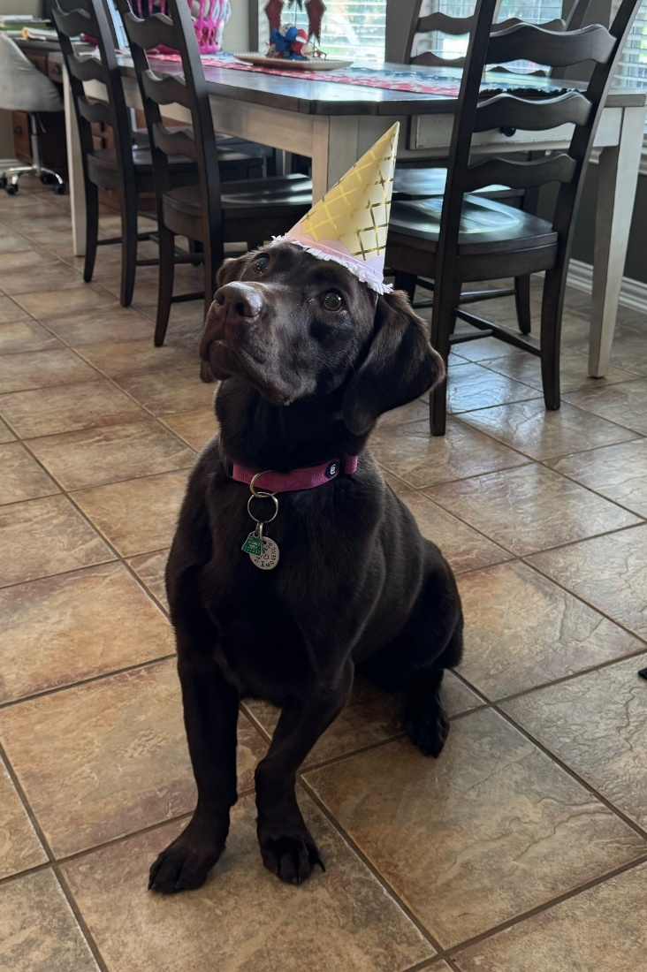
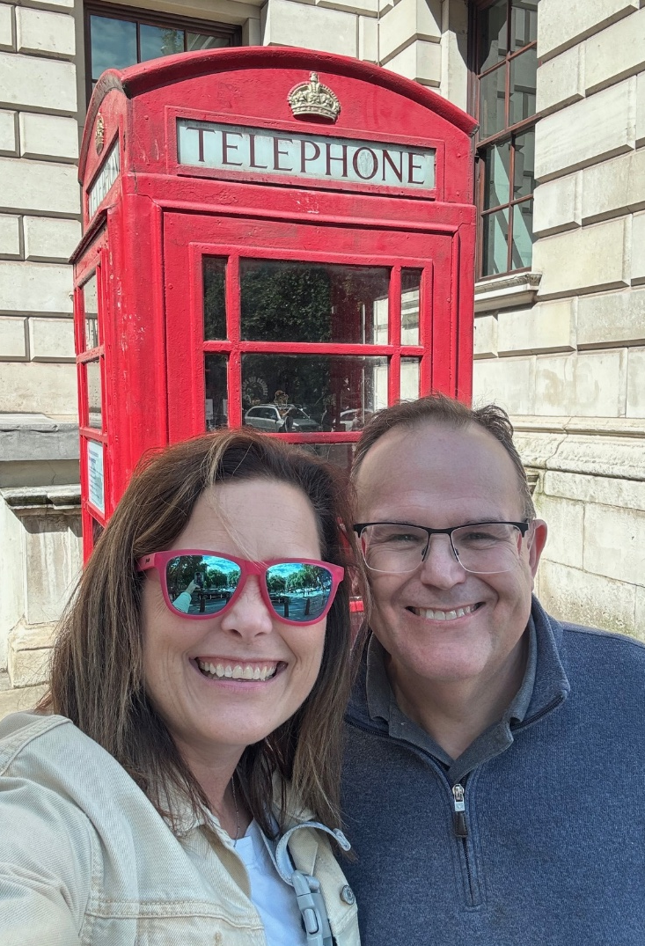
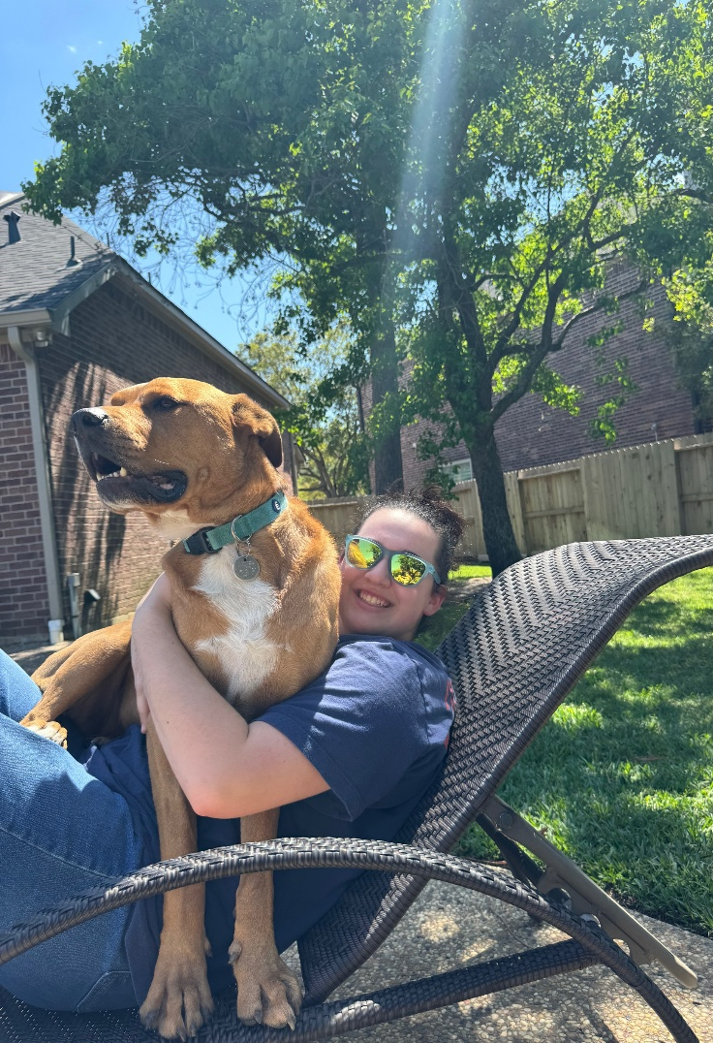
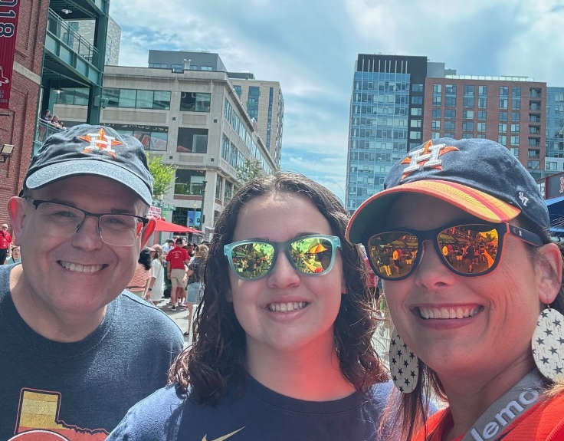
About Me - My Family

Slide 6
Introductions – Take Three Minutes and Meet A Classmate
Name
Undergrad Institution and Major
Your hometown
Something Interesting about a Classmate
What is a Role of a Lawyer?

Slide 7
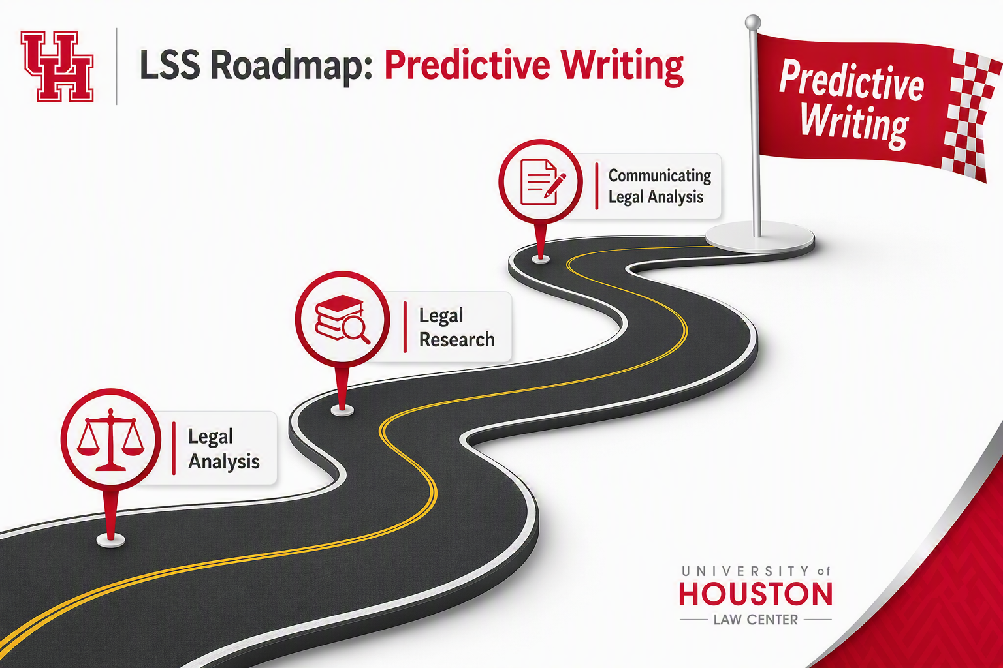

Slide 8

Lawyering Skills & Strategies
Legal Analysis –
What is “The Law”?
How to Apply the Law to a Set of Facts
Legal Research - How to Find It
Legal Communication -How to Write About It

Slide 9
Section B1 - Law Firms
Firm 1 | Firm 2 | Firm 3 | Firm 4
Sadie Bostwick | Parker Champagne | Jared Whitehurst | Trey Gaw
Audrey Griffith | Madeline Kampesi | Matthew Love | Promise Maduka
Conor McNabnay | Emily Moon | Rhett Price | Joyclin Ranjith
Lilly Sills |  | Le An Tran

Slide 10
FALL SEMESTER
Closed Memo Discussion and Conference – 5%
Research Assessment – 15%
Final Memo Research Report and Conference – 10%
Final Memo - 30%
LRW Exam (last class meeting-Nov 19) – 30%
Professionalism and Ungraded Assignment Completion –10%

Slide 11
Books: Becoming a Legal Writer and The Bluebook
The Bluebook is a guide to legal citation
Provides required format for citing to cases, statutes, secondary sources, law review articles, etc.
ICW Exercises
Mandatory, but ungraded
Due dates in Course Schedule

Slide 12
Other Syllabus Items
Class Attendance & Promptness
Assignment Deadlines
Artificial Intelligence
Canvas and Class Communication
Legal Writing Center
Legal Research Labs and Office Hours
Mandatory Research Lab, Sept. 1 – 12:00 p.m. – 12:50 p.m. (Room 102A) – Free food provided

Slide 13
Professors Truskett’s Contact Info
Office in O’Quinn Building: 342L
Email: hatruske@central.uh.edu
Office Telephone: 713-743-4638
Office Hours: Tuesdays & Thursdays 4:00 pm–5:00 pm; and via appointment

Slide 14
Fall Semester: Predictive writing
Making a Legal Prediction

Slide 15
Legal Analysis: IRAC
Issue
Rule
Application
Conclusion
Notes:
THIS IS WHY WE BRIEF CASES TO TRACK THESE SAME TOPICS

Slide 16
Legal Analysis: IRAC
Either rule-based or based on prior cases
Issue
Rule
Application
Conclusion
Identify the QUESTION you must answer
Find the law that governs HOW you answer the question
APPLY that law (the rules) to your facts
Predict the answer to your question
Notes:
THIS IS WHY WE BRIEF CASES TO TRACK THESE SAME TOPICS

Slide 17

Becoming a Legal Writer
Reading and Briefing Cases

Slide 18

Let’s PRACTICE WITH MCBoyle v. United States
Get into your law firms and discuss Exercise 3.2.1 (15 minutes)
Focus on your answers to these questions
What was the issue before the court?
What was the governing rule?
Any sub-rules?
Both sides differed on whether “ship” could be included as “vehicle” under the statute. How and why?
What argument did the court find more convincing? The dissent?
Be ready to share and appoint someone to speak for your firm
Do you think a court would include a drone as a “motor vehicle”?

Slide 19
Homework for Thursday 9/27
-Read BLW Ch. 1 (pages 3-5); Complete Exercise 1.1 (questions 1-3)
-Read and brief Mustafa and Sobin cases and Jalen Fox email (available on Canvas)
-By 2 PM Wednesday, Firm 2 members e-mail me one PowerPoint slide about you that has a photo of your choice that best describes you. Each student will take no longer than 2 minutes at the beginning of class to present that slide to the class.
Looking Ahead: Complete Legal Research Modules 0.1-0.4 by 5:00 p.m. Tuesday, 9/1

